Slide 2
Talent poster: an exercise for articulating your skills and motivation
Notes:
- The exercise starts with imagining that you have landed your dream job and are being praised for your skills and motivation. Those are both important factors also in the recruitment process.
- Goal is to collect resources you can use in later job applications and practice the articulation of your skills and motivation.
- In the exercise the idea is to discuss first to stimulate your thoughts, and then write them down for your personal use. The exercise is also well suited for independent use.
- Tip for finding out your skills: you can check the curriculum and the courses you’ve taken, they should state the learning outcomes. This could be used also as an independent exercise or preparation for this one.

Slide 3
Imagine...
You have started your dream job, things are going well, and you feel confident about your work. Your boss is also happy and comes to thank you for the great work. Your skills have clearly made a good impact. The boss also says that your values fit well with the company culture and your motivation is excellent.
Kuva: Bradley Hook
Notes:
We draw attention to two essential issues in the story: motivation and skills. (These are both on the top in a recruitment survey, when employers were asked about the most important factors in the recruitment; in Finnish: https://duunitori.fi/tyoelama/rekrytointitutkimus-2022-rekrytointipaatos)
The exercise concentrates first on motivation and then on skills.

Slide 4
Why is your boss impressed?
How do your values match the company values?
How do you show your motivation towards the job?
What can you provide to the company or the larger community through your work?
What can the work provide to you? How does the work boost your motivation?
Notes:
The title refers to the frame story on the previous slide, and this slide prompts to reflect on motivation and its sources based on the story.
Good recruitment is optimal for both parties. We have our own needs, values and sources of motivation, but here we practice articulating them especially from the perspective of impressing the employer. It is good to note that salary is a common motivating factor in a job, but it does not convince the employer. Instead, you can articulate, for example, that you are motivated to achieve high goals. In any case, it is worth considering other motivational factors in addition to this. In general, it is also easier to apply for a job when you are really interested in it.

Slide 5
Examples of work-related motivations: you may want to…
Learn something new
Influence attitudes; make a difference
Help people; share information
Be creative; solve problems
Achieve goals; get recognition
Have responsibility; get management experience
Collaborate; feel belongingness
Notes:
When doing this exercise, it is good to be gender-sensitive. For example, you can discuss in a group whether there are gender stereotypes associated with different motivational factors. Students should be encouraged to express different sources of motivation; for example, women can also be motivated by performance-related pay or career development opportunities.

Slide 6
Share with a person next to you
What motivates you?
What makes the work meaningful?
What kind of values and goals do you have concerning the work?
Notes:
At this point, participants can be paired up to discuss the topics briefly (e.g. for 5 minutes). This can help to articulate and clarify the motivation.

Slide 7
Write down, why were you hired? What’s important in a job?
Use one post-it per reason
Think about your values and motivation concerning work, even a mission if you have one
GOAL: to show the employer why you are motivated to excel in the job
Notes:
The instructions refer to the frame story, in which the employer has noted the excellent motivation. The idea is to summarise the reflections raised in the previous slides and discussion here and write them down as a resource for the job search. The frame story was about a dream job, so it will be useful to adapt these to the job you are applying for. In a group setting, you can reserve 5 to 10 minutes for the task and be flexible.

Slide 8
What skills and competences do you have? Examples of so-called soft and hard skills
Teamwork
Communication
Creativity
Problem-solving
International relations
Attention to detail
Foreign languages
Project management
Customer service
ICT skills
Programming languages
Data mining
Analytics
Design
Lean manufacture
Notes:
Now we are moving from motivation to skills. Skills are typically divided into soft (which are not directly related to a specific job, are difficult to measure and assess, for which some people have an innate ability but which can still be practised) and hard skills (technical skills, which are specific to teach and learn, and may be required to perform a specific task). In this slide, examples of soft skills are on the left, and examples of hard skills are on the right. In the middle are examples of skills that could be a little bit both. Skills can be classified in different ways, but the main purpose of the slide is to illustrate the wide range of skills people can have and to remind that different skills are equally valuable. Skills can also be discussed in a gender-sensitive way: it is important to note that soft and hard skills are not related to gender. All genders can have different skills, and it is good to bring out all kinds of skills when looking for a job.

Slide 9
Share with a person next to you
What skills do you have that could be useful in a job?
Where have you learned them?
How can others notice your skills?
Notes:
At this point, participants can be paired up to discuss the topics briefly (e.g. for 5 minutes). This can help to articulate and clarify the skills.

Slide 10
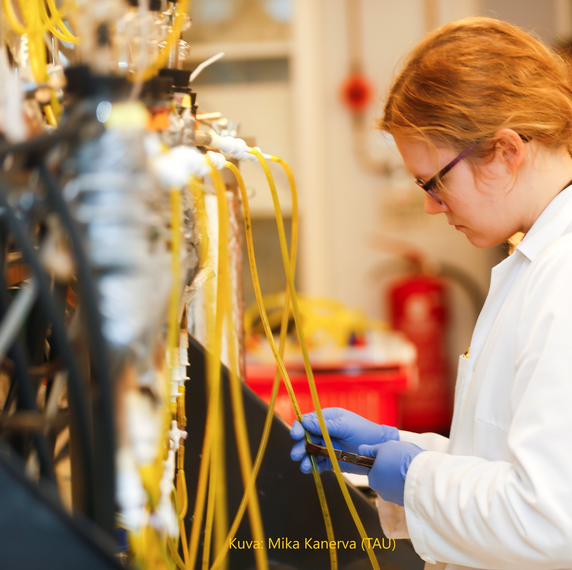
Write down, what are you good at? What skills do you have?
Use one post-it per skill
For each skill, write down how you have used it, how it is reflected in your work, or how you learned it
GOAL: to articulate your skills in a more tangible and credible way
Notes:
The idea is to summarise the reflections raised in the previous slides and discussion here and write them down as a resource for the job search. You can spend more time on this, if it’s available, as everyone will certainly have several skills. Participants can also be asked to choose for example three skills to focus on. It could be helpful if the group has already listed their skills or reflected on them, so that the participant can choose those that they would like to use in their work the most. Abstract skills should be broken down into smaller and more concrete skills, e.g. project management -> time management: responsibility for scheduling teamwork. The written-down skills can be used later in the job search, depending on what skills are asked in the job description and which strengths you want to highlight.

Slide 11
Wrapping up
Continue filling your poster at home and update as you gain new skills
Attach your post-its on a poster, and you’ll have an easy to use and editable tool for job search
Remember to adjust your job application to match the task description and the needs of the company
Kuva: Andrea Piacquadio
Kuva: Zainul Faki

